Slide 1
Gyürki Zoli
@GreenFox

Slide 2
Nope

Slide 3
Debuging
Practise
I2C

Slide 4
Exam(git, enum, strcmp);
I2C

Slide 5
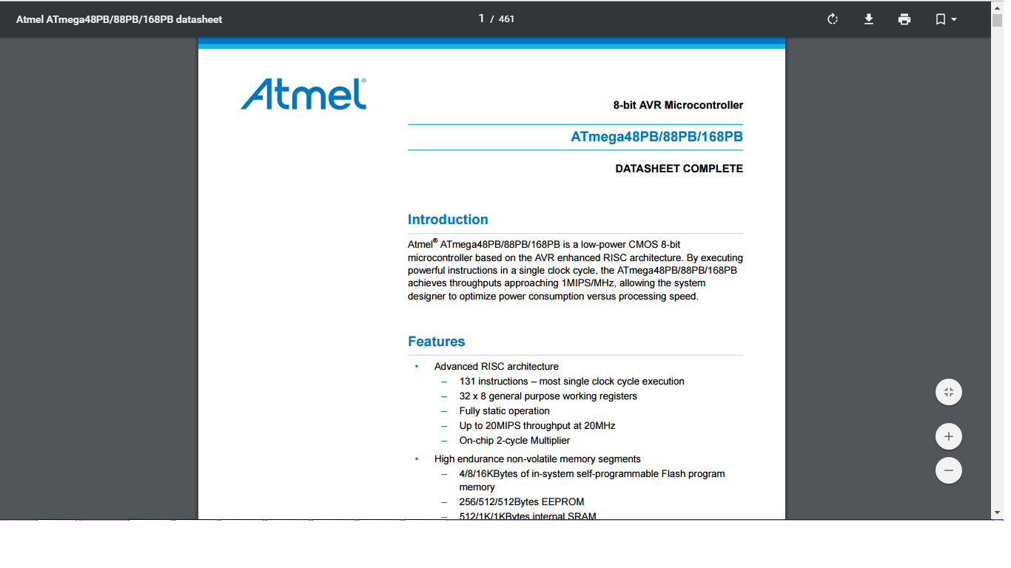
Bro’s for life

Slide 6
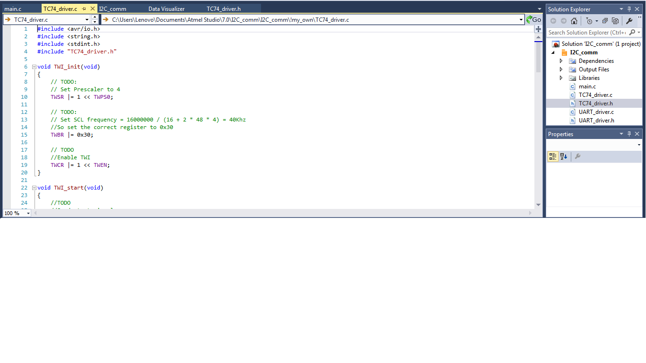

Slide 7
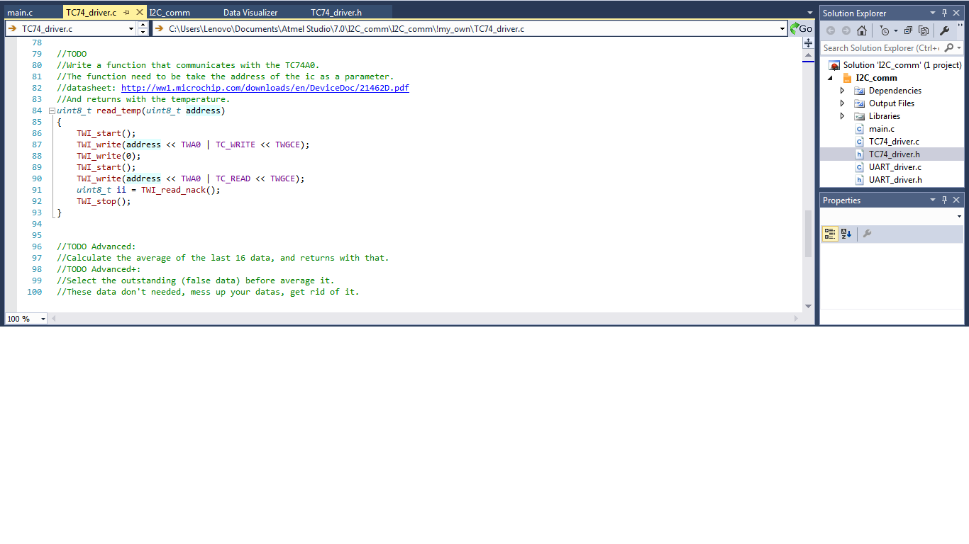

Slide 8
Thank U & Have a nice weekend!

